Slide 1
Random Forest Method
Learn How Ensemble Learning Can be Used in Predictive Problems

Slide 2
Contents
01
02
Understanding Bootstrapping
Introduction to Bagging
03
04
What is Random Forest?
Random Forest Algorithm Steps
05
06
Out-of-Bag Error
Variable Importance
07
08
Predicted Probabilities in Random Forest
Python Functions for Random Forest

Slide 3
Understanding Bootstrapping
Bootstrapping is a powerful statistical method for estimating the sampling distribution of an estimator by resampling with replacement from the original sample.
Versatile Application
Especially useful when the sampling distribution of an estimator is not a standard distribution
Universal Method
Can be applied to any statistical inference problem regardless of complexity
Historical Origin
Named after the phrase "to pull oneself up by one's bootstraps" - succeeding despite limited resources

Slide 4
Why Bootstrapping Matters
Overcoming Normality Assumptions
Many conventional statistical methods including correlation, regression, t-tests, and analysis of variance make assumptions about normality. When these assumptions are violated, such methods may fail to provide statistically valid inference.
Data-Based Simulation
Bootstrapping is steadily becoming more popular as a statistical methodology. It is intended to simplify the method of statistical inferences, sometimes in situations where no analytical answer can be obtained.
Computational Advances
As computer processors become faster and more powerful, the time and effort required for bootstrapping decreases to levels where it becomes a viable alternative to standard parametric techniques. Its use in ML applications has increased, whereas earlier it was limited to inferential problems.

Slide 5
Bootstrapping Illustration
Suppose the original sample is:
12, 23, 11, 29, 34, 38, 41, 45, 6
Original Median = 29.00
We draw multiple random samples using bootstrapping to generate a sampling distribution of the sample median. Assuming B=1000 bootstrap samples, the 25th value and 975th value will provide a 95% confidence interval for the median.
 | Sample 1 | Sample 2 | Sample 3 |  |  | Sample B
 | 23 | 11 | 6 |  |  | 41
 | 23 | 29 | 45 |  |  | 45
 | 29 | 11 | 11 |  |  | 11
 | 29 | 29 | 29 |  |  | 34
 | 34 | 34 | 11 |  |  | 34
 | 38 | 34 | 38 |  |  | 38
 | 41 | 41 | 41 |  |  | 41
 | 45 | 45 | 41 |  |  | 45
 | 41 | 11 | 6 |  |  | 6
Median | 34.00 | 29.00 | 29.00 |  |  | 38.00
Sampling distribution of sample median is generated
Assuming B=1000, 25th value and 975th value will provide 95% confidence interval for median

Slide 6
Introduction to Bagging
What is Bagging?
The term "Bagging" was introduced by Breiman (1996)
Stands for "Bootstrap Aggregating"
An ensemble method that combines results from classifiers trained on multiple resamples
Key Points
Bagging improves performance for unstable classifiers which vary significantly with small changes in the data set
It can also be applied using different classifiers for a given sample

Slide 7
Bagging Method Framework in ML
Bagging involves two fundamental steps that work together to create robust predictions:
Sample Generation
Generate B bootstrap samples for the training data - random samples with replacement from the original dataset
Classification Models
Use majority vote on the classification results from all models
Train the Model
Train a classifier or regression function using each bootstrap sample independently
Regression Models
Calculate the average of the predicted values from all models

Slide 8
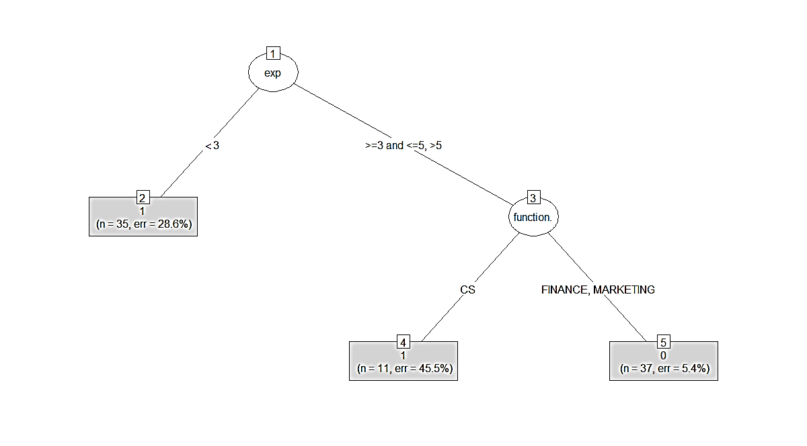
Random Forest is "Bagging of Decision Trees with Random Feature Selection"
Many such decision trees are obtained to grow
a Random Forest.

Slide 9
What is Random Forest?
Random Forest (or random forests) is an ensemble classifier that consists of many decision trees and outputs the class that is the mode of the class's output by individual trees.
1995
First proposed by Tin Kam Ho of Bell Labs as "random decision forests” and was later extended into the Random Forest algorithm by Leo Breiman in 2001.
2. Innovation
Combined Breiman's "Bagging" idea with random selection of features
3. Today
One of the most powerful and widely used machine learning algorithms

Slide 10
Random Forest Algorithm Steps
Bootstrap Sampling
Create many resamples using training data
2. Grow a Forest
Grow each tree on an independent bootstrap sample obtained from the training data
3. Random Feature Selection
At each node, select m variables at random out of all M possible variables (independently for each node), then find the best split on the selected m variable
4. Maximum Depth
Grow the trees to maximum depth without pruning
5. Aggregate Predictions
Vote or average the trees to get predictions for new data

Slide 11
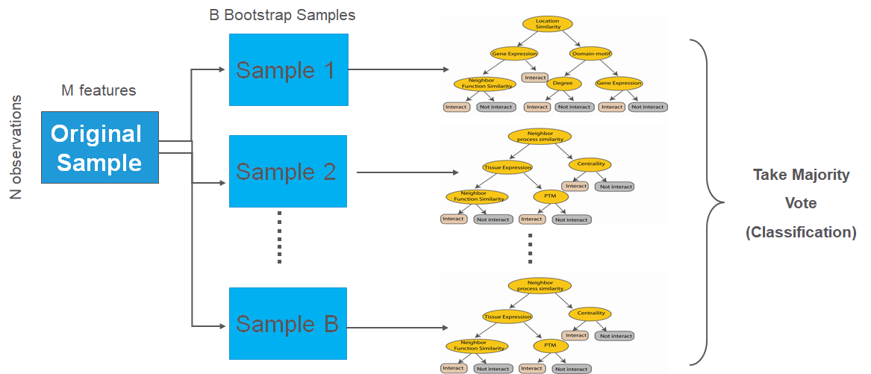
Visual Overview of Random Forest
This diagram illustrates how multiple decision trees are trained on different bootstrap samples and their predictions are aggregated to produce the final Random Forest output.

Slide 12
Out-of-Bag Error and Variable Importance
Bootstrap Sample Characteristics
In bootstrap samples of data, approximately 2/3 of original values get included in each sample, leaving about 1/3 out
For Each Tree:
Perform classification of the leftover 1/3 data using the decision tree and calculate the misclassification rate = Out of Bag (OOB) Error Rate
For each variable in the tree, permute the variable's values and compute the OOB error
Compare to the original OOB error - the increase indicates the variable's importance

Slide 13
Aggregating Results from Individual Decision Trees
The final step involves aggregating OOB error and importance measures from all trees to determine overall model performance and feature significance.
OOB Error Rate
Calculate the overall percentage of misclassification across all out-of-bag predictions. This provides an unbiased estimate of the model's generalization error without requiring a separate validation set.
Variable Importance
Compute the average increase in OOB error over all trees when each variable is permuted. Variables causing larger increases in error are more important for prediction accuracy.

Slide 14
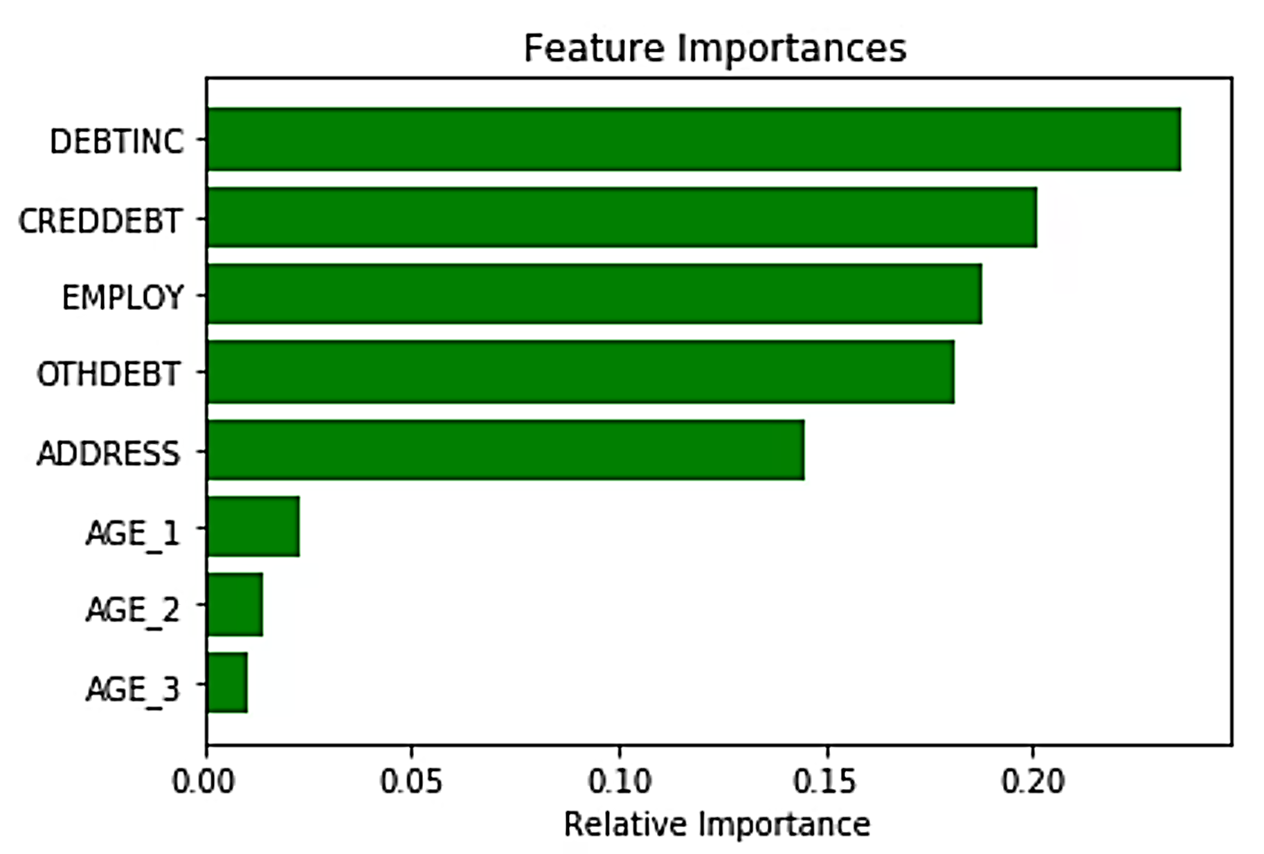
Variable Importance Visualization
Understanding Feature Impact
The variable importance plot shows which features contribute most to the model's predictive power. Features are ranked by their average increase in OOB error when permuted.
This helps identify the most influential predictors and can guide feature selection and model interpretation.

Slide 15
Predicted Probabilities in Random Forest
In a Random Forest classifier, predicted probabilities are computed by averaging the predicted probabilities from all individual decision trees in the ensemble.
Individual Tree Output
Each tree outputs the proportion of samples of each class in its terminal leaf node
Forest Aggregation
The forest aggregates these probability values across all trees to produce the final probability for each class
Stable Estimates
This results in more stable and reliable probability estimates compared to a single decision tree
Using above predicted probabilities, ROC-AUC can be computed.

Slide 16
Essential Python Functions for Random Forest
1. Model Initialization
RandomForestClassifier() or RandomForestRegressor() - Create model instance with parameters like n_estimators, max_depth, and random_state
2. Training the Model
.fit(X_train, y_train) - Train the Random Forest on your training data, building multiple decision trees
3. Making Predictions
.predict(X_test) - Generate predictions on new data. Use .predict_proba() for probability estimates
4. Feature Importance
.feature_importances_ - Extract which features contribute most to predictions, essential for model interpretation
5. Model Evaluation
.score(X_test, y_test) - Calculate accuracy or R² score. Use with sklearn.metrics for detailed evaluation

Slide 17
Key Takeaways
Bootstrapping Foundation
Bootstrapping provides a robust method for resampling and estimating distributions without relying on parametric assumptions
Random Forest Power
Random Forest extends bagging by adding random feature selection, creating diverse trees that work together effectively
Bagging Ensemble Strength
Bagging combines multiple models trained on bootstrap samples to reduce variance and improve prediction stability
OOB Validation
Out-of-bag error provides built-in model validation and variable importance measures without separate test data

